Slide 1

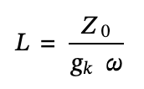
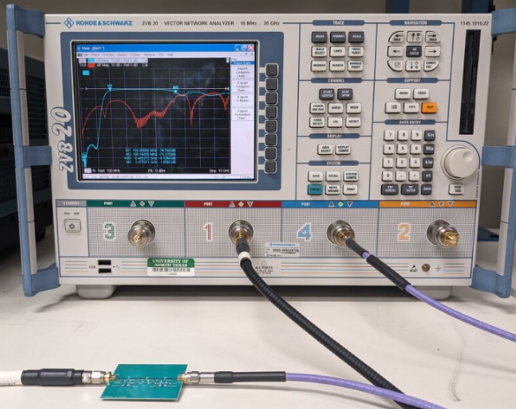

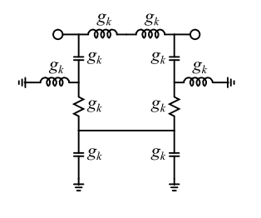
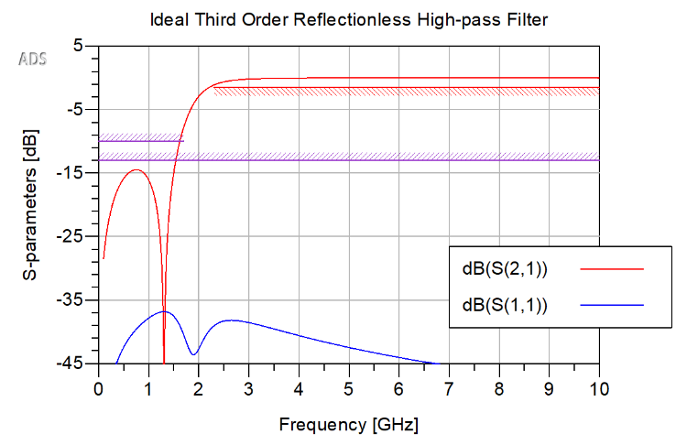
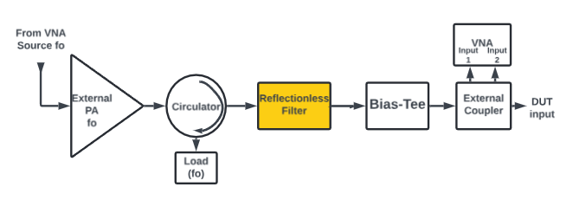
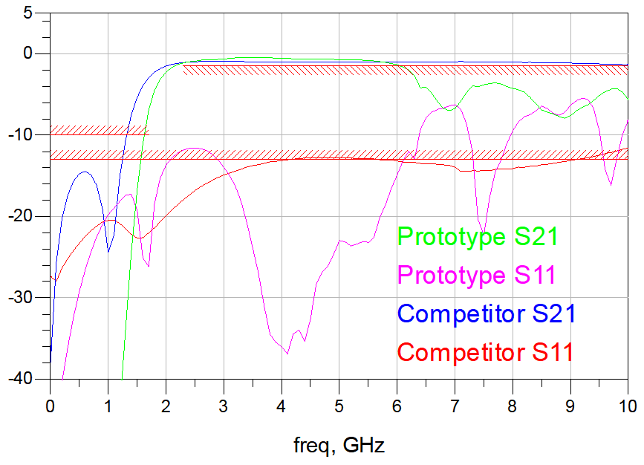
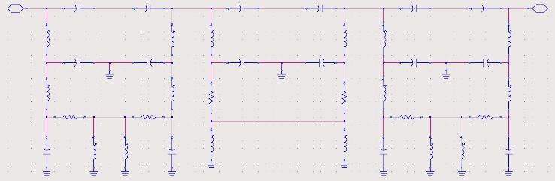
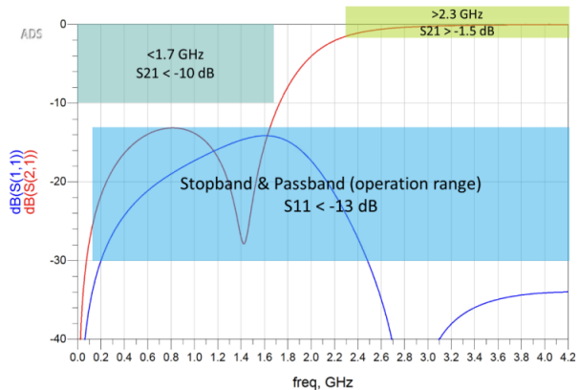
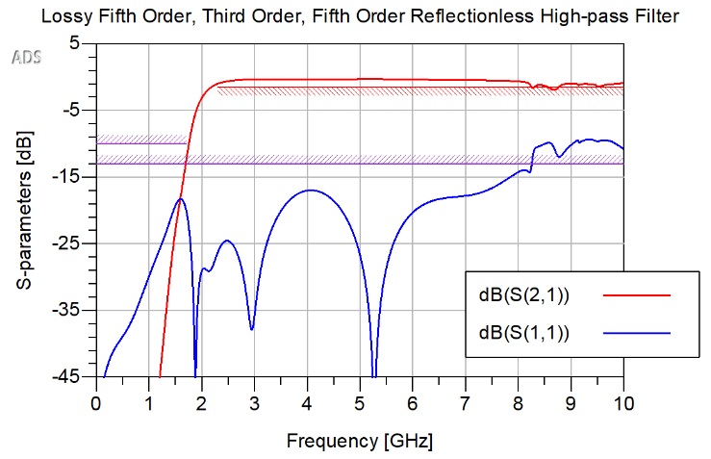
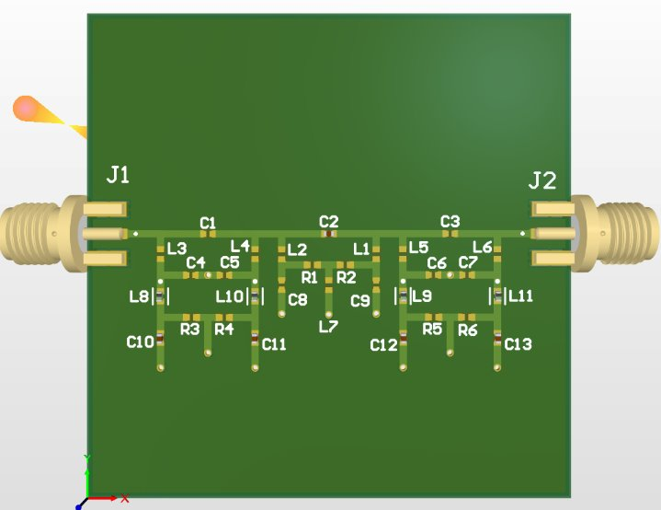
A Reflectionless Filter for Load-pull Measurements: Design, Simulation, & Experimental Characterization
Robert Valois, Eli Gabaldon & Olasubomi Borishade
Advisor: Dr. Hung Luyen
UNT Department of Electrical Engineering Denton, Texas
Fall 2024
Abstract
Load-pull measurements are one of the most widely used test setups to support the research and development of various RF components and devices. Signal reflections, if occurred at any stage of the test system, negatively impact the characterization of devices under test. A common source causing these unwanted reflections is RF filters, which are conventionally designed to reflect energy outside their passband. Using a reflectionless filter that can suppress out-of-band reflections helps increase the accuracy of such a test setup. In this project, a high-pass reflectionless filter was designed, simulated, fabricated, and experimentally characterized, with an intended usage for testing applications covering a wide range of modern devices operating in RF/microwave spectrum up to 6 GHz. The developed filter suppresses out-of-band reflections below 2.3GHz and provides high transmission coefficients within the 2.3-6.0 GHz passband.
Introduction
Method
Fabrication & Testing
Traditional filters are designed to exhibit matched impedance in the passband, allowing desired signals to pass through smoothly. In the stopband, they are purposely mismatched, causing signals to reflect along the signal path. These reflections degrade the signal by bouncing back and forth between the source and filter ports. This out-of-band reflection can introduce unwanted effects. Existing solutions, like attenuators and isolators, reduce these reflections but add gain, increasing costs, size, and failure risks.
The filter was designed using Matthew A. Morgan’s patented reflectionless filter topology.
Equations from Morgan’s book utilize parameters such as characteristic impedance, admittance, cutoff frequency, and a scaling factor g_{k}
Fabrication
PCB Manufacturer: JLCPCB
Final assembly was performed manually using a reflow oven.
Final cost: $174
Testing
Equipment: Rhode and Schwarz ZVB 20 vector network analyzer.
KPI: Scattering parameters
Parameters: 3000 frequency points between 100 MHz to 10 GHz.
Problem Statement
Figure 3: Component equations
A load-pull test varies input and output impedance to find a device's optimal operating point.
Impedance variance in the signal path causes reflections, potentially damaging the source and DUT.
Traditional filters reflect energy outside their passband, creating standing waves and further signal degradation.
Attenuators suppress reflections. However, they reduce the input signal source.
Figure 10: Prototype Test Setup
Results
Figure 4: Low-pass Reflectionless Filter Topology
Figure 5: Simulation of Ideal Reflectionless High-pass Filter
Results (Fig. 11):
Our prototype shows favored roll-off at the transition band.
The competitor exhibits a superior S21 frequency range and favored suppression of S11.
Future improvements:
Limit use of inductors with low self-resonant frequency
Experiment with bandpass reflectionless filter
Transform from lumped to distributed elements
The inductance and capacitance for a high-pass filter with a 1 dB cutoff frequency of 2.3 GHz were calculated as:
L = 6.0 nH
C = 2.47 pF
S21 and S11 plots from an ADS simulation of a third-order high-pass reflectionless filter using the calculated component values are shown in Fig. 5.
dB
Figure 1: Block diagram of a active load-pull test set-up.
Design
In Fig. 1, The circulator used below 10 GHz significantly reduces the setup bandwidth, reflecting signals outside its operating range, which could lead to unwanted resonances. A reflectionless filter can absorb these unwanted resonances.
Target Specification
Figure 11: Prototype vs. Competitor (Mini-Circuits; ZXHF-K23+) VNA Results
No active components are to be used
Substrate materials and passive components can be used
The PCB prototype should not exceed 300cm²
Should have female connectors and be suitable for 3.5mm male connections
The operating temperature of the device should be from -55°C to 100°C
Conclusion
This project addresses the industry need for higher accuracy in load-pull measurements of DUTs by absorbing signal reflections that hinder device characterization. To achieve this, we designed a novel high-pass filter to absorb these reflections. Simulations showed promising results, though the prototype didn’t fully meet specifications. Transforming our design into distributed elements offers a potential path for improved performance and cost efficiency.
Figure 7: Schematic of a Fifth Order, Third Order, Fifth Order Reflectionless High-pass Filter Cascade
References
[1] Matthew A. Morgan. “Coupled-Ladder Reflectionless Filters”. In: 2023 IEEE MTT-S Latin America Microwave Conference (LAMC). 2023, pp. 135–137. DOI: 10.1109/LAMC59011.2023.10375604.
[2] M. A. Morgan. Reflectionless Filters. Norwood, MA: Artech House, 2017.
[3] SDC9 - Reflectionless High-pass Filter Design for Load-Pull Measurement Setups. IEEE IMS TC-3 Microwave Measurements Committee, TC5-Filters Committee, 2024
Figure 2: Sample Scattering Plot as Performance Metric
Figure 8: ADS Simulation of Our Design
Figure 9: PCB Layout in Altium Designer

